Slide 1

State of Our World’s Children and Life Expectancies
The Fantastic 4
Ben Valois: Our Fearless Leader
-Sharon Fitzsimmons: Data Collector
-Renae Rohde: The Scribe
-Mark McGrail: The Machines Have Turned Against Us, Starting With Him

Slide 2
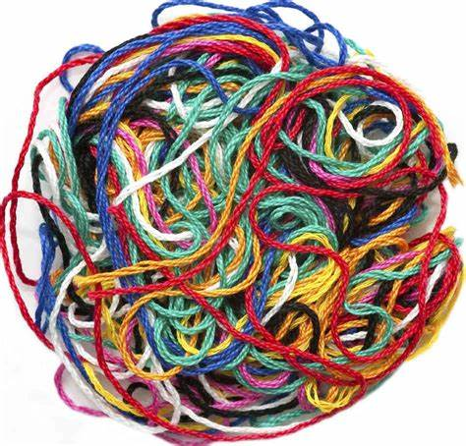
Introduction and Topic Selection
We are studying “Survival Rate to the Last Grade of Primary School: Females as a Percent of Males” and “Life Expectancies of Females as a Percent of Males”
Our topic changed several times
We were not studying what we initially thought we were
It contributes to social good
Actual Depiction of Our Project Process ->
Notes:
Renae

Slide 3
Datasets/Previous Conclusions
SOWC - UNICEF data
UN data
Women tend to live longer than men
It is important for making it to the last grade of primary school to be 100%
Notes:
Sharon

Slide 4
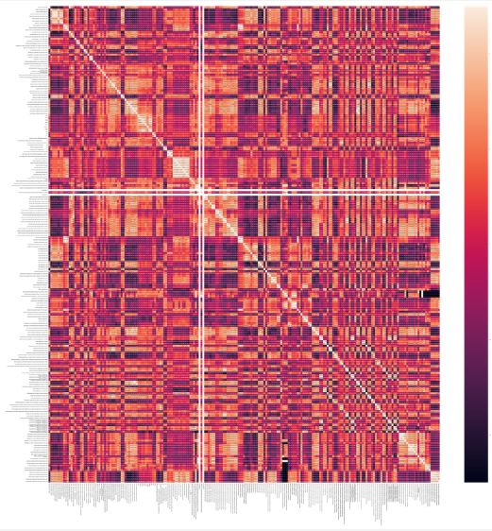
Process
Data Cleaning
Box Plots
More Data Cleaning
Heatmaps
Correlations
Predictive Modeling
Notes:
Mark
Taking Dataset, format for pandas
Box Plot, look at 75th and 25th percentiles
Splicing sheets into giant sheet
Gigantic Heatmaps, x>103.206 and x<99.1825
Look at Higher end, where correlations <.69 exist

Slide 5
Correlations
Life Expectancy of Females as a Percent of Males for Countries well-over 100% (0.69 and -0.69)
Minimum Acceptable Diet 6-23 Months (r = 0.7065)
Households With At Least One ITN (insecticide-treated nets) (r = -0.7091)
Population Annual Growth Rate (r = -0.6971)
Stunting Prevalence in Children Under 5 Ratio of Poorest to Richest (r = 0.7027)
Notes:
Ben

Slide 6
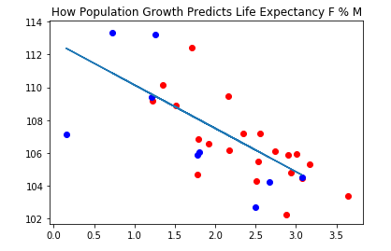
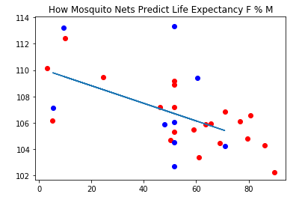
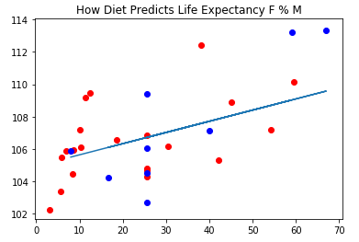
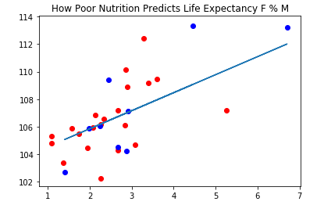
Data Modeling
Predicting Life Expectancy of Females as a Percent of Males based on the correlations
Notes:
Sharon

Slide 7
cont.
Notes:
Sharon

Slide 8
Conclusions
Based upon our data analysis and modeling:
Countries that had more households with at least one mosquito net also had men’s life spans that were closer to those of women.
There were not as many strong correlations as we thought there would be for the variable we were looking at
Notes:
Ben

Slide 9

Problems We Encountered
Mark’s technology problems
Issues with dataset formatting
Misunderstanding of variables
General process of dealing with large amounts of data
Notes:
Mark
Everything I touched was ruined
Datasets not given in “codable” form, but readable form
“Survival Rate to the last grade of Primary School: Females as a % of Males”, survival isn’t the same as mortality
Took a good 3 minutes for heatmaps to run, even when looking at just higher percentile of countries.
Lack of results (countries are different)

Slide 10
Future Work
More data modeling
Deeper understanding of why women tend to live longer than men
Help countries whose values fall too far below or above 100% for life expectancy ratios in the real world (social good)
Notes:
Renae

Slide 11
References
Barthold, D., Nandi, A., Mendoza Rodríguez, J. M., & Heymann, J. (2014). “Analyzing Whether Countries are Equally Efficient at Improving Longevity for Men and Women.” American Journal of Public Health, 104(11), 2163–2169.
BBC. (2012). “Fruit Flies Offer DNA Clue to Why Women Live Longer.” BBC News, 2 Aug 2012. Retrieved from https://www.bbc.com/news/health-19093442.
International Cooperation and Development. (nd). "EU-ISEM Project Helping Girls to Complete Secondary Education." European Commission. Retrieved from https://ec.europa.eu/europeaid/case-studies/eu-isem-project-helping-girls-complete-secondary-education_en.
Huebler, Friedrich. (2008) “Survival Rate to the Last Grade of Primary School.” International Education Statistics. Retrieved online from https://huebler.blogspot.com/2008/02/survival-rate-to-last-grade-of-primary.html

Slide 12
References cont.
Lone, Patricia. (1996) "Commentary: Keeping Girls In School." UNICEF.org. Retrieved from https://www.unicef.org/pon96/edgirls.htm .
Sundberg, L., Agahi, N., Fritzell, J., & Fors, S. (2018). “Why is the gender gap in life expectancy decreasing? The impact of age- and cause-specific mortality in Sweden 1997-2014.” International Journal of Public Health, 63(6), 673–681.
UNICEF. (2017). “State of the World’s Children.” New York, NY: United Nations Children’s Fund.
United Nations. (2019). “The Sustainable Development Agenda.” Retrieved from https://www.un.org/sustainabledevelopment/development-agenda/
United Nations Department of Public Information. (2015). “The Milennium Development Goals Report.” Retrieved from https://www.un.org/millenniumgoals/2015_MDG_Report/pdf/MDG%202015%20PR%20Regional%20LAC.pdf
United Nations Statistics Division. “UN Data: A World of Information.” Retrieved from http://data.un.org/

